Slide 1
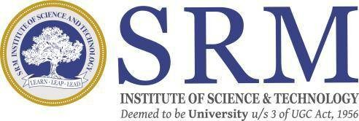
Real-Time Object Detection and Distance Mapping
SRM INSTITUTE OF SCIENCE AND TECHNOLOGY
SCHOOL OF COMPUTING
DEPARTMENT OF COMPUTING TECHNOLOGIES
18CSP109L - MAJOR PROJECT
Batch ID: 1
Student 1 Reg. No: RA2111003011009
Student 1 Name: KINTHALI SAKETH
Student 2 Reg. No: RA2111003011033
Student 2 Name: PUDI SAI KRISHNA
Guide name: Dr. V. Raghavendra
Designation: Assistant Professor Department: Computing Technologies

Slide 2
Introduction
Computer vision has seen dramatic improvement with advances from deep learning-based object detection models. Among these, YOLO (You Only Look Once)-based models have emerged as the de facto choice for object detection in real time, offering an optimum trade-off between speed and precision. While object detection provides a system with the ability to detect and localize an object within a scene, it lacks the ability to perceive spatial relationships among the detected object and the camera. This shortcoming is overcome by distance mapping, providing invaluable spatial insight that helps improve decisions across applications from autonomous systems to assistive technologies for humans.
The "Real-Time Object Detection and Distance Mapping" project is one that brings these two fundamental abilities together to form an integrated, real-time system. The project utilizes YOLOv8, also one of the newer versions of the YOLO system, for object detection, which is characterized by its lightweight design, high-speed inference, and high accuracy, ideal for use for real-world applications on commodity hardware without the need for costly GPUs.

Slide 3
Problem Statement
In today’s world, many technologies rely on being able to detect and understand objects around them. While models like YOLO have made huge strides in quickly identifying objects in real time, they still face a big limitation: they can’t tell us how far away these objects are from the camera or sensor. This lack of spatial awareness creates problems in areas where knowing the distance to an object is crucial—like in autonomous driving, safety systems, and assistive technologies.
Self-driving cars need to not only detect pedestrians or other vehicles but also understand how far away they are to avoid crashes.
Assistive technology for visually impaired individuals could be much more helpful if it could detect objects in their path and tell them how close those objects are, helping them move around more safely.
Industrial systems that track equipment and people need to know how close objects are to each other to avoid accidents and optimize operations.

Slide 4
Objectives
The goal of the "Real-Time Object Detection and Distance Mapping" project is to create a system that not only detects objects quickly and accurately but also estimates how far those objects are from the camera or sensor, all in real time. By using the YOLOv8 deep learning model, the system can identify various objects—like people, vehicles, or obstacles—and then calculate their distance using methods like pixel-to-meter scaling and focal length estimation. This will give a clearer understanding of the environment, making it easier to interact with and respond to what's around you.
The system will provide both visual and auditory feedback. It will display the location of detected objects through bounding boxes and also use text-to-speech technology to warn users when objects are getting too close. This is particularly useful in scenarios like autonomous driving, helping visually impaired individuals navigate, or improving safety in industrial settings—any situation where knowing the proximity of objects can help make better, safer decisions.

Slide 5
Proposed System
The proposed system for the "Real-Time Object Detection and Distance Mapping" project aims to bridge the gap between object detection and spatial awareness in a way that is both efficient and accessible. Using the YOLOv8 deep learning model, the system will be able to detect objects in real time, such as people, vehicles, or obstacles, within images or video streams. This real-time detection will be combined with a unique feature: distance estimation. By using geometric methods like pixel-to-meter scaling and focal length estimation, the system will calculate the physical distance between the detected objects and the camera, providing valuable spatial awareness.

Slide 6
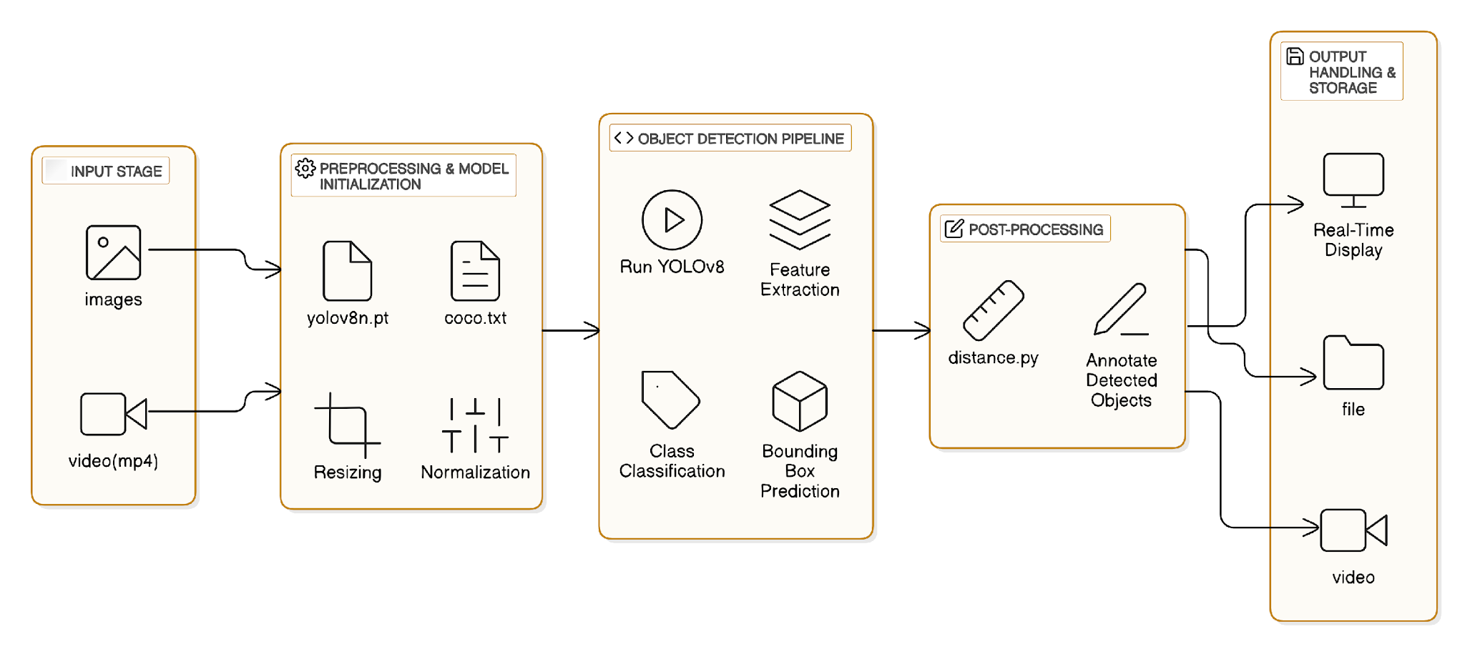
Architecture Diagram

Slide 7
Methodology
The project leverages pre-trained YOLOv8 models (yolov8m.pt, yolov8n.pt) for object detection, utilizing datasets detailed in the coco.txt file for fine-tuning and validation, and testing inputs including both images and videos (e.g., bus.jpg, 33.mp4, 34.mp4) to assess model performance in static and dynamic contexts.
Input data undergoes preprocessing—resizing, normalization, and color space conversion—to align with YOLOv8's requirements, with video streams processed frame-by-frame using OpenCV for real-time detection. The detection pipeline is implemented through Python scripts like object_detection.py for images, real_time.py for live feeds, and video_with_distance.py for proximity estimation. YOLOv8 detects objects by dividing the input into grids and predicting bounding boxes, class labels, and confidence scores.
Post-processing involves adding bounding boxes and labels, applying confidence thresholds, and optionally integrating tracking to enhance clarity and reduce false positives. Evaluation includes varying confidence and NMS settings, analyzing precision, recall, and MAP, and optimizing via dataset fine-tuning and hyperparameter adjustments to balance speed and accuracy—choosing between the faster yolov8n.pt and more accurate yolov8m.pt.
The final deployment phase enables real-time applications like surveillance and automation, with scalability for mobile and web platforms, and compatibility with edge devices such as Raspberry Pi or NVIDIA Jetson, thereby broadening its practical utility.

Slide 8
References
Fan, Xiangyu. "YOLOv8-Lite: A Lightweight Object Detection Model for Real-time Autonomous Driving Systems." IECE Transactions on Emerging Topics in Artificial Intelligence 1, no. 1 (2024): 1-16.
Huang, Huadong, Binyu Wang, Jiannan Xiao, and Tianyu Zhu. "Improved small-object detection using YOLOv8: A comparative study." Applied and Computational Engineering 41 (2024): 80-88.
Verma, Urvashi, Anshul Kalia, and Sumesh Sood. "YOLOV8: An Enhanced Object Detection Model for Distance Estimation." International Journal of Intelligent Systems and Applications in Engineering 12, no. 21s (2024): 3852.
Silva, Diego A., Kamilya Smagulova, Ahmed Elsheikh, Mohammed E. Fouda, and Ahmed M. Eltawil. "A Recurrent YOLOv8-based framework for Event-Based Object Detection." arXiv preprint arXiv:2408.05321 (2024).
Wang, Gang, et al. "UAV-YOLOv8: A Small-Object-Detection Model Based on Improved YOLOv8 for UAV Aerial Photography Scenarios." Sensors 23.16 (2023): 7190. ​
Wang, X. "BL-YOLOv8: An Improved Road Defect Detection Model Based on YOLOv8." Sensors 23.20 (2023): 8361. ​

